Slide 1
HEALTH MONITORING SYSTEM
NAME: SURAJ BG
USN: 1AT16CS109
GUIDE: HEMALATHA KN

Slide 2
CONTENTS
Abstract
Introduction
Flow Diagram
Literature survey
Implementation
Proposed System
Future Advancements
Conclusion
Paper Publication Details
Bibliography

Slide 3
ABSTRACT
In the recent years of health care development, we witness huge amounts of data flow to track few parameters of a person and alert the guardian in case of any emergency of the patient. This establishes a need for a single platform where users can monitor the data on a real time basis. This paper talks about health monitoring systems which allow patients to be monitored without having a need to visit the doctor which can be implemented with market sensors. The module gives the necessary opportunity for all day service for the patients which can be recorded by the doctor and can receive a notification in any case of emergency. This platform forms a great use when a patient is under frequent checkup or under home care for a long period of time.

Slide 4
INTRODUCTION
The growing network of devices connected to IOT are increasing every day. Most of these technologies are being used in developing healthcare effectively. In this paper we present various situations in which the Health monitoring system finds useful for the physician and the patients.
Health monitoring system acts useful when during road accidents, where the patient can be monitored all the way to hospital.
Patients who have to be monitored for a long period of term which causes a nurse to be expensive, and can adopt a health monitoring system.
The module helps patients who live in distant areas which lack a hospital facility.

Slide 5
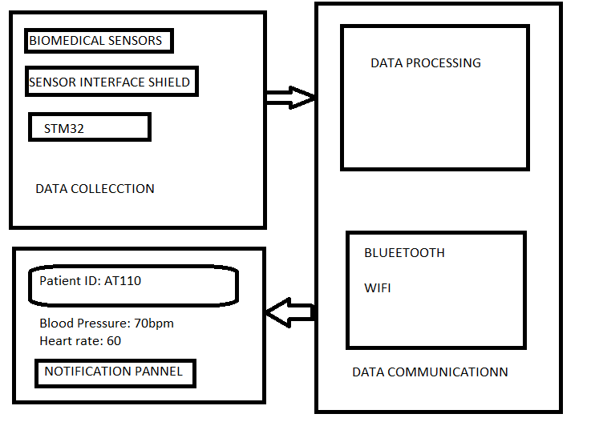
FLOW DIAGRAM

Slide 6
LITERATURE SURVEY
Jorge Gomez: Developed a personal health diagnosis based on the symptoms of the patient. A huge amount of collected data is used to analyse the disease and risk of the patients. Franca discussed that the innovations of the new generation systems are the development of continuous monitoring features for the patient and the improvement of workflows and productivity of medical personal.
Giovanni Baldus : developed an approach to maintain health care data of a patient collected in different geographic locations. The data is available to doctors, hospitals, laboratories etc., to check the medical history of the patients.intelligent systems,which detect the disinfected articles and alerts the medical staff to wash hands after the contact with the disinfectant articles.

Slide 7
Franca Delmastro :Data sensed and transmitted through the wireless devices are received in the local system that needs to support accessing of data in heterogeneous formats, can be useful in building real time applications and to be updated in the mobile application of the doctor as well as the user.
Pioggia, IoT techniques can be used to promote healthcare in a better way. The health related information could be interacted with doctors who are in emergency.

Slide 8
IMPLEMENTATION
The health monitoring system is classified into Data collection, Data monitoring and notification for the user to communicate.
Biometric Data collection
Data can be collected by various sensors attaching to the patient's body shown in figure 1. The data can be collected by a microcontroller platform and mapped into patients data records. This initially can also map multiple sensors to the patients database. A sensor platform can be made use.
Data processing
A patient's body parameters can be monitored regularly and can be used to keep track of patients history and is updated onto the cloud.

Slide 9
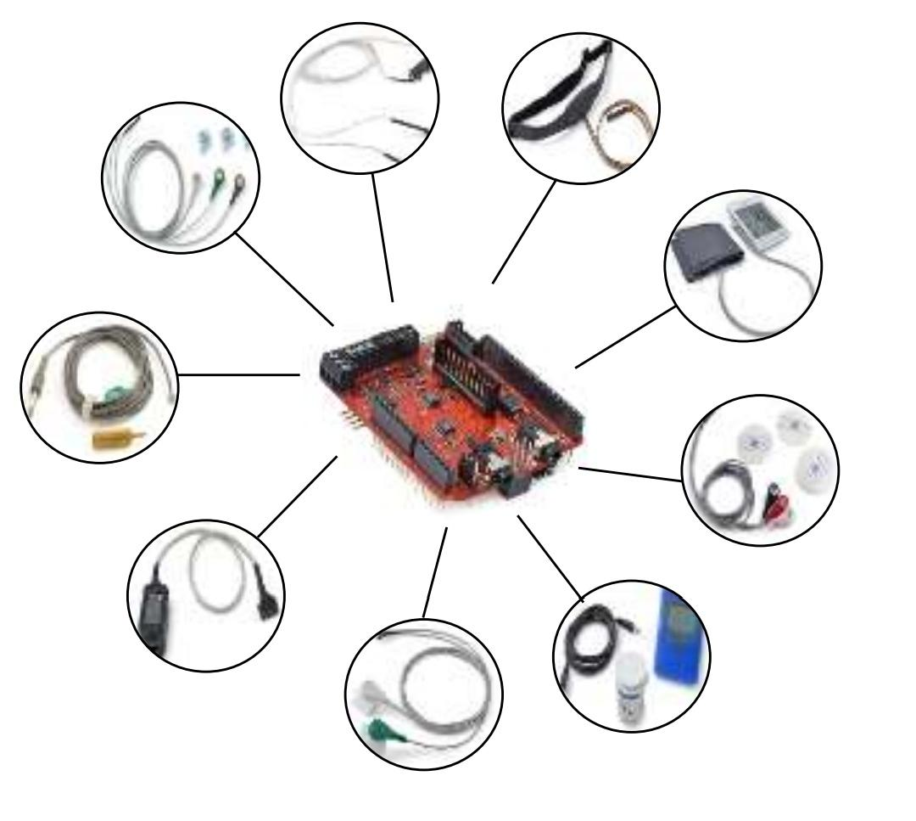
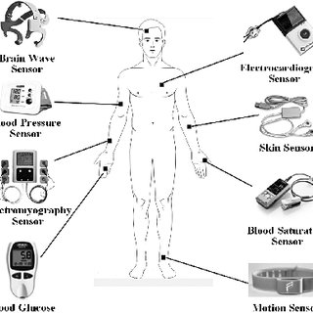
SENSOR PLATFORM Figure 1. DATA ACQUISITION
User Interface
The purpose of the user interface is to determine the parameters of the patient's body and notify the caretaker in an emergency case to be handled. This often consists of a mobile application or PC application with a navigational display.

Slide 10
PROPOSED SYSTEM
An Native Visual Studio Application which works on both windows as well as a smartphone which displays the patients data with an emergency notification alert.
The caretaker incharge gets a emergency notification in case any fluctuations are found in the patient’s body.
An LCD display is present in the discovery board which shows the log of patients' records stored in the microcontroller. The display consists of a touchscreen display which allows us to navigate through the patient's record.
The date is pushed onto the cloud and it can be fetched by the pc application and stored in a local database which is used to display on the app. The application also consists of updating or deleting a patient's history for doctors convenience.

Slide 11
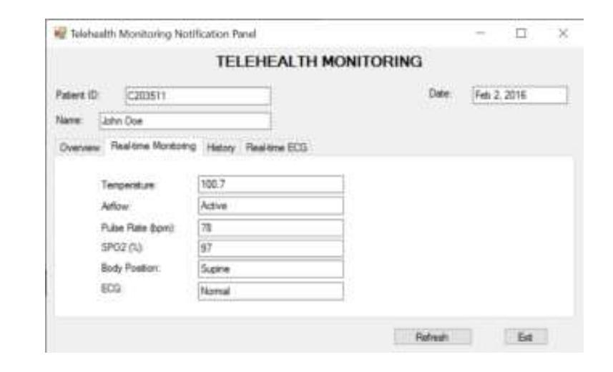
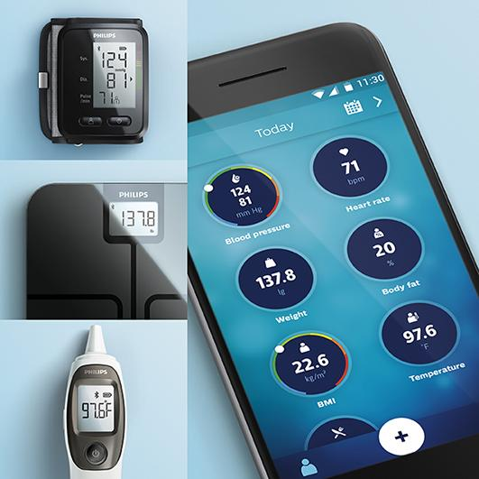
WINDOWS APPLICATION SMARTPHONE APPLICATION

Slide 12
FUTURE ADVANCEMENTS
The healthcare market is one of the major in which there is a huge growth. Everyone can afford a health monitoring system or a wearable band which keeps them in regular update with body fitness.
The bands cover blood pressure, body temperature, heartbeat and more advancements which is leading a major growth in healthcare.
The future of the healthcare industry is more reliable on health monitoring systems for consumer safety and reliability.

Slide 13
CONCLUSION
As discussed in the paper with a standard microcontroller used and with right peripherals we can make a health monitoring system affordable to people.
This has great biomedical sensors which help capture data and push onto the cloud so that the emergency message can be sent in case the threshold value is crossed.
The microcontroller sends the value to the caretaker, and is synchronized frequently which helps the doctor react accordingly, the past records of the patient pushed on to the cloud helps the doctor get an clear view and monitor the patient.

Slide 14
PAPER PUBLICATION DETAILS
Implementation paper published in IJSART International Journal for Science and Advance Research In Technology, Approved in Volume 6, Issue 4, April 2020.
The URL of the paper in journal is as follows:
http://ijsart.com/Home/IssueDetail/36383

Slide 15
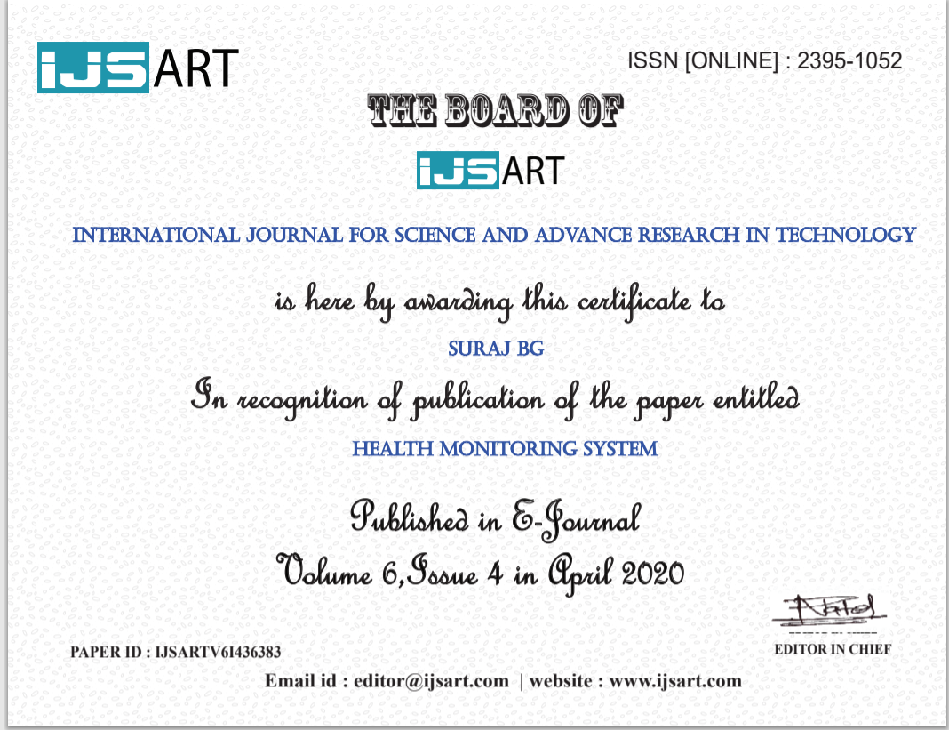

Slide 16
BIBLIOGRAPHY
S. S. Al-Majeed, I. S. Al-Mejibli and J.Karam, "Home telehealth by Internet of Things (IoT)," 2015 IEEE 28th Canadian Conference on Electrical and Computer Engineering (CCECE), Halifax, NS, 2018, pp. 609-613.
W.-J. Yi, O. Sarkar, S. Mathavan and J.Saniie, "Design flow of wearable heart monitoring and fall detection system using wireless intelligent personal communication node," IEEE International Conference on Electro/Information Technology (EIT), pp.314-319, 2018.
J. Cancela, M. Pastorino, M. T. Arredondo and O. Hurtado, "A telehealth system for Parkinson's disease remote monitoring. The PERFORM approach," 2013 35th Annual International Conference of the IEEE Engineering in Medicine and Biology Society (EMBC), Osaka, 2016, pp.7492-7495.

Slide 17
THANK YOU

